Slide 1
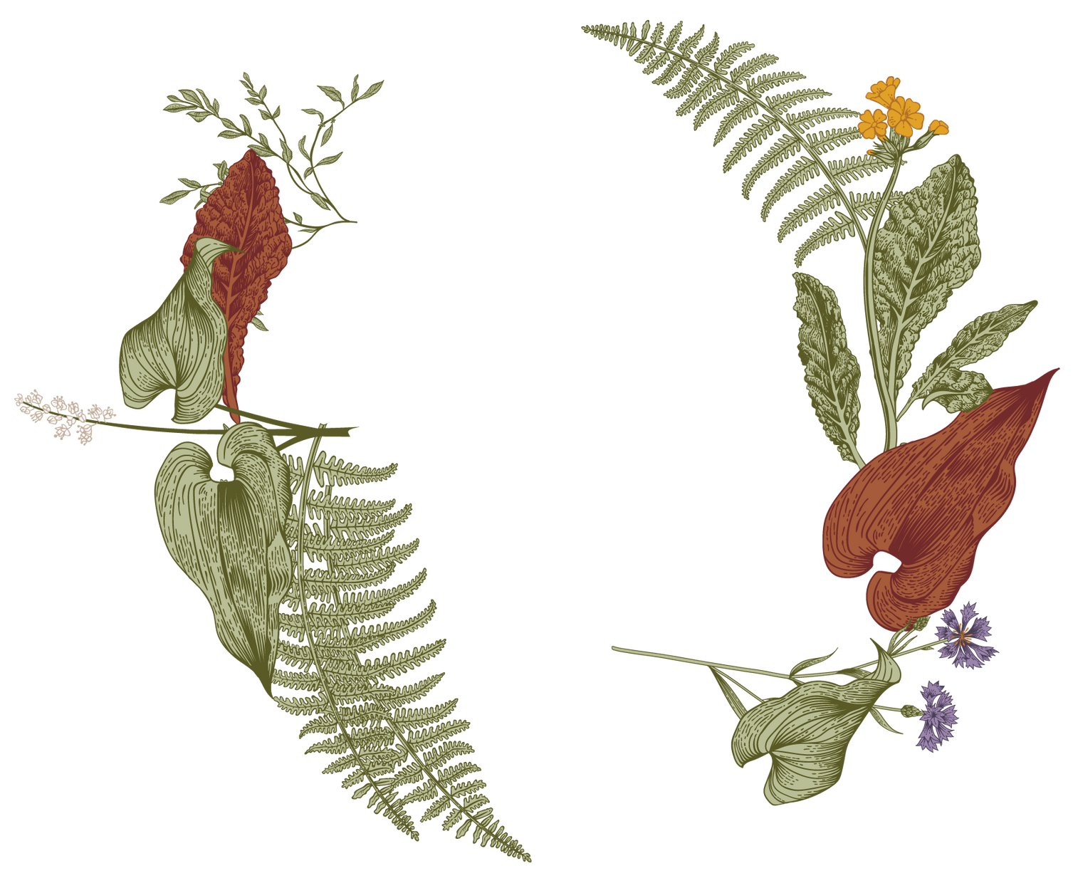




Rajiv Gandhi University of Knowledge Technologies – Basar #DEPARTMENT of CSE:-
Integrated Multi-Model System for Crop, Yield,and Fertilizer Forecasting
TEAM : -
K.Naresh – B200951
M.Vamshi – B200949
P.Sai Kiran - B201239
GUIDED BY :-
Laxminarayana sir
GUIDED BY :-
Laxminarayana sir

Slide 2

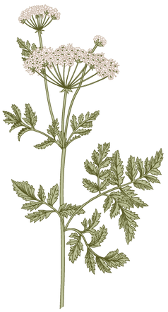



Agenda
A
Introduction
Primary goals
The Problem
The Solution
Our Model
Future Scope
2

Slide 3
Introduction
→ Agriculture is the main source of livelihood for most of Indians population.
→ The sector faces major challenges due to climate change, soil degradation, and lack of technology.
→ Nearly three-quarters of families depend on rural incomes, making agricultural improvement essential.
→ Farmers often lack data-driven guidance for crop, yield, and fertilizer decisions.
→ This project uses machine learning to provide accurate predictions and promote sustainable farming.

Slide 4
Primary goal
→ To develop an integrated system for crop, yield, and fertilizer forecasting.
→ To analyze soil nutrients and weather parameters for accurate predictions..
→ To assist farmers in selecting the most suitable crop for their land.
→ To recommend the right fertilizer and quantity for better productivity.
→ To promote sustainable and data-driven farming practices.

Slide 5
The Problem Statement
In most circumstances, a farmer's decision on which crop to cultivate is impacted by his intuition as well as other irrelevant aspects such as generating fast profits, being oblivious of market demand, overestimating the potential of a soil, and so on.
The farmer's unwise decision could put his family's financial status under severe strain. Perhaps this will lead to debt, which is one of the numerous contributing factors to the significant number of farmer suicides and decline in the number of farmers
6

Slide 6
About DataSets:
The project uses three datasets to build an Integrated Multi-Model System for crop recommendation, yield prediction, and fertilizer suggestion. Each dataset provides specific information required by the respective models.
Crop Recommendation Dataset :
→ Contains soil nutrient (N, P, K), weather (temperature, humidity, rainfall), and soil pH data.
→ Target column is the crop type to predict the most suitable crop for given soil and weather conditions.
Crop Yield / Production Dataset :
→ Contains crop, state, season, and cultivated area.
→ Targets are production (total output) and yield (production per hectare).
→ Used to forecast expected production and yield for a given crop, location, and season.
Fertilizer Dataset :
→ Contains fertilizer names and their NPK composition.
→ Used to recommend the best fertilizer for a crop either by crop name or by matching soil NPK requirements
.
Data Cleaning & Preparation: :
→ Text columns were cleaned by removing extra spaces and converting to lowercase for consistency.
→ Categorical features were encoded using LabelEncoder so models can process them.
→ This ensures uniformity across datasets and prevents mismatches.
→ Enables smooth integration of crop, yield, and fertilizer prediction models.
8

Slide 7
The Solution
→ Develop a smart Crop, Fertilizer, and Yield Prediction System using Machine Learning.
→ Predict the most suitable crop by analyzing soil conditions, temperature, rainfall, and location(state).
→ Recommend the optimal fertilizer type and quantity based on soil nutrient levels (N, P, K) and crop requirements.
→ Estimate expected production and yield using regression-based predictive models.
→ Help farmers make informed decisions, plan efficiently, enhance productivity, and promote sustainable farming.

Slide 8
The Model
→ Inputs: Soil (N, P, K, pH), weather, and location data.
→ Processing: Data cleaning, normalization, and encoding.
→ Crop Prediction: Classification models (Random Forest, Decision Tree).
→ Fertilizer Recommendation: Based on soil nutrients and crop needs.
→ Yield Prediction: Regression models to estimate production.
→ Output: Recommended crop, fertilizer, and expected yield.

Slide 9
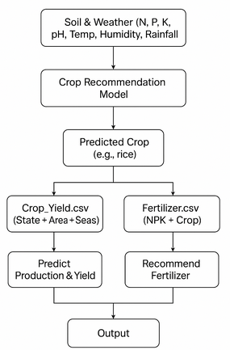
Project Flow
8

Slide 10
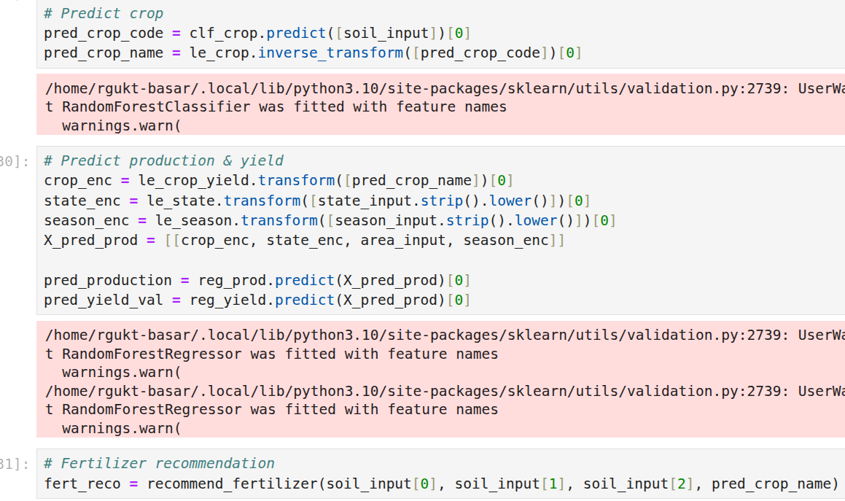
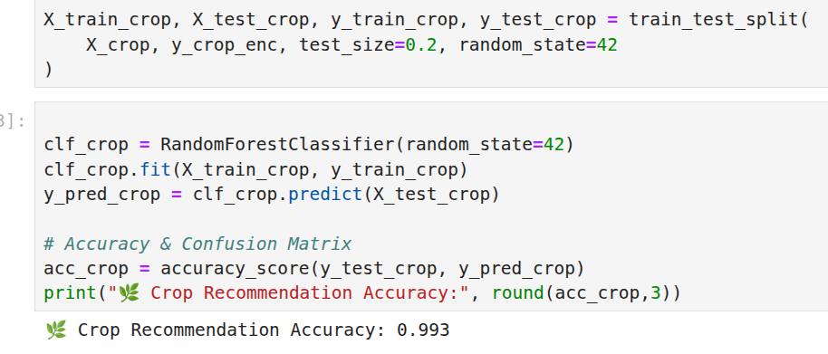
Fig1:
Integrate models predicting & recommendation.
Fig 2:
Model fitting & accuracy checking
8

Slide 11
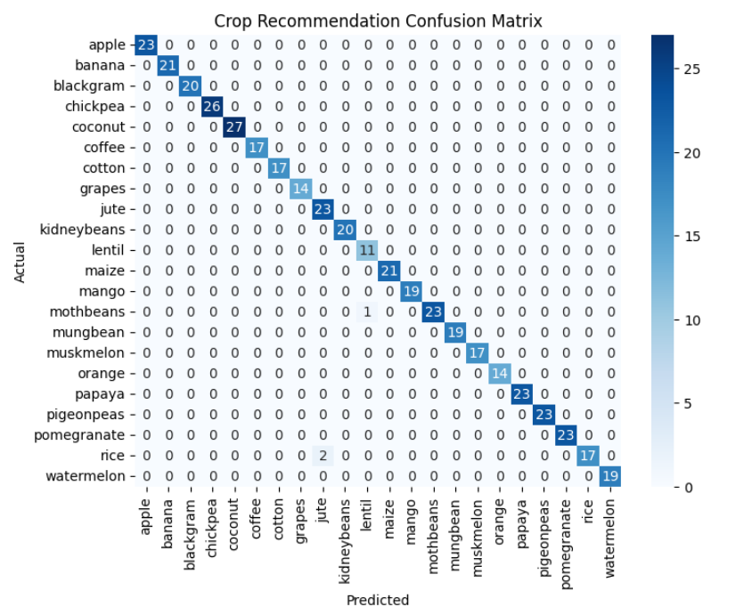
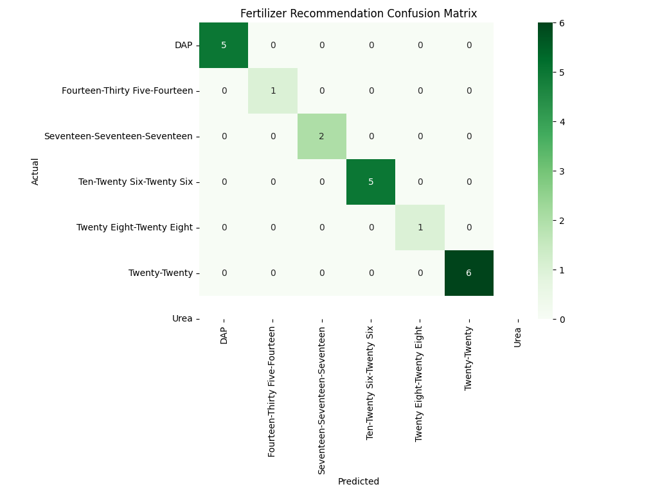
Confusion matrices:
8

Slide 12
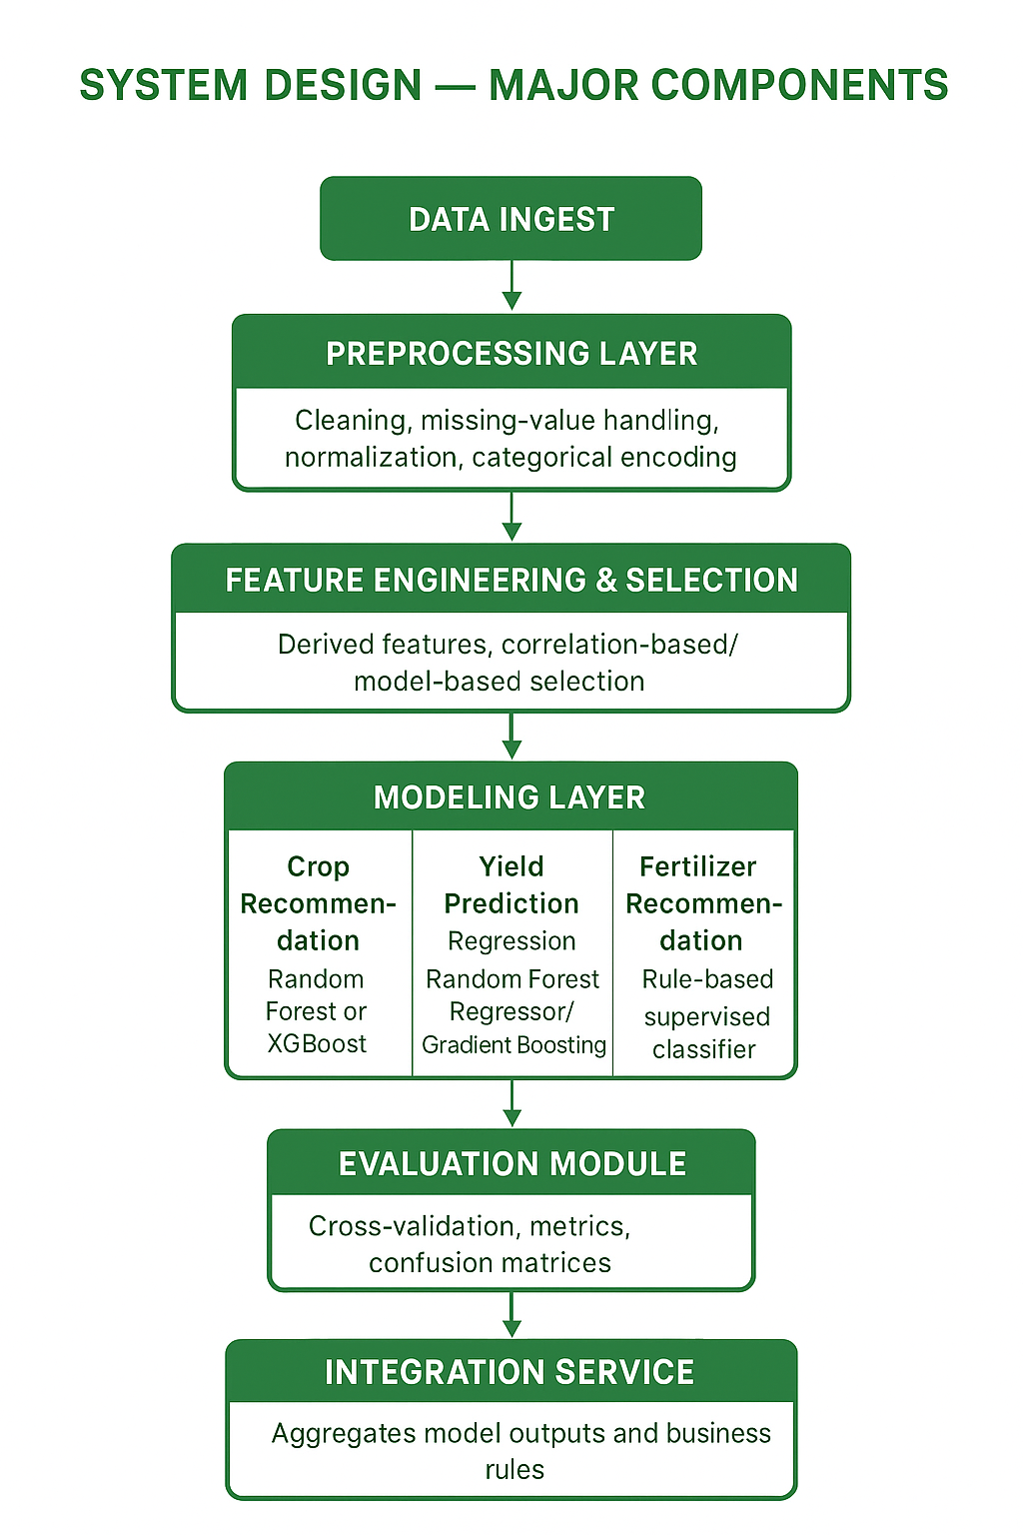

Slide 13
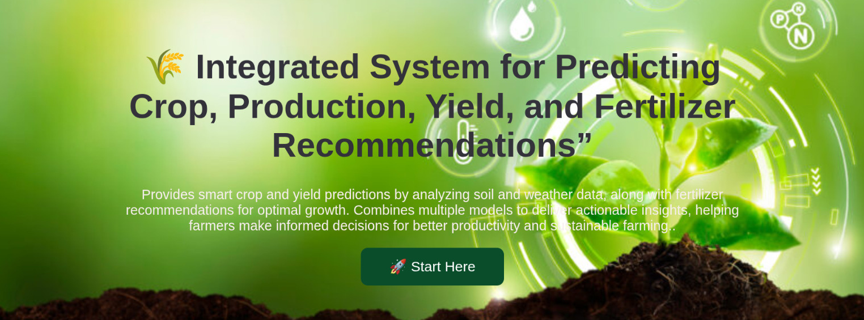
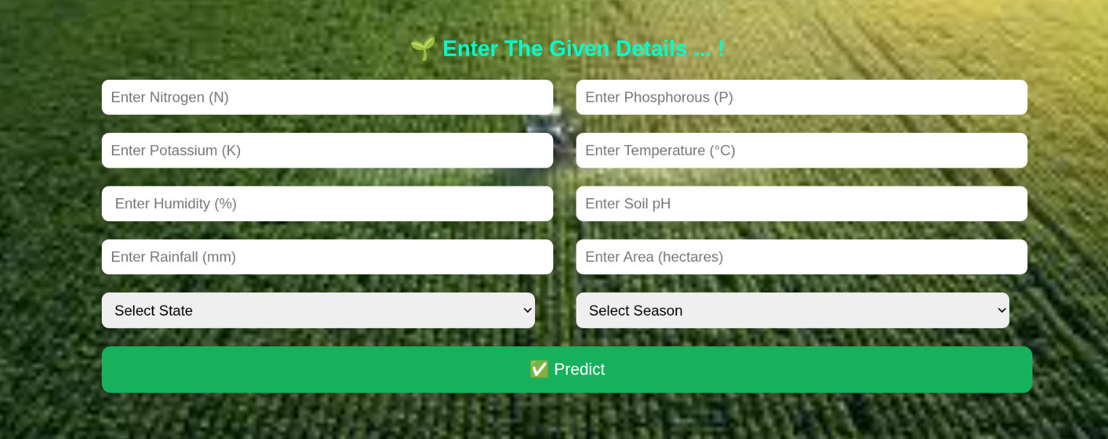

Slide 14
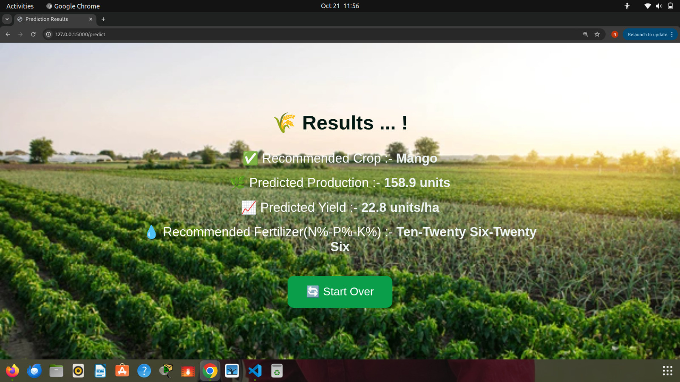

Slide 15
Future Work
→ Integrate pest and disease prediction using image .
→ Satellite Imagery Analysis: Use free satellite data (Google Earth, Sentinel, NASA) to monitor soil moisture, crop coverage, and regional trends. Extract features like NDVI and feed them into ML models for large-scale crop, yield, and fertilizer forecasting..
→ Include market demand and price prediction to guide crop selection.
→ Develop a mobile/web app to provide personalized crop and fertilizer recommendations.
→ Implement advanced ML/DL models (LSTM, CNN) for better yield and crop forecasting.
13

Slide 16
Conclusion
→ Provides data-driven recommendations for crop selection, fertilizer use, and yield prediction.
→ Uses machine learning models with soil, weather, and location data for accurate predictions.
→ Supports sustainable and precision farming, improving productivity and resource efficiency.
→ Enables real-time monitoring and decision-making, paving the way for smart and automated agriculture.
Applications: Crop and fertilizer planning,Yield prediction and farm monitoring
14

Slide 17
References
1. Faezeh Akhavizadegan, Javad Ansarifar, Lizhi Wang, Isaiah Huber, and Sotirios V Archontoulis. A time-dependent parameter estimation framework for crop modeling. Scientific reports.
2. Javad Ansarifar, Lizhi Wang, and Sotirios V Archontoulis. An interaction regression model for crop yield prediction. Scientific reports, 2021.
3. Recommender System lecture python notebook by Simran Nagpurkar
4. Crop Recommendation using ML] (https://ieeexplore.ieee.org/document/9734173) Kaggle : (https://www.kaggle.com/datasets/atharvaingle/crop-recommendation- dataset)
5. Fertilizer Kaggle: (Plant Disease Classification - ResNet- 99.2
6. Research Paper :https://www.ijnrd.org/papers/IJNRD2303270.pdf.
7. Crop-and-Fertilizer-Recommandation-System-using-FLASK by simran2097
15

Slide 18

“
Green is the path of our better future
”

Slide 19
“
Thank you
”

